Slide 1
A Study of the Effects of Underlying Assumptions in the Reduction of Multi-Object Photometry of Transiting Exoplanets
M. Ryleigh Fitzpatrick
Advisor: Dr. Caitlin Griffith
Lunar and Planetary Laboratory

Slide 2
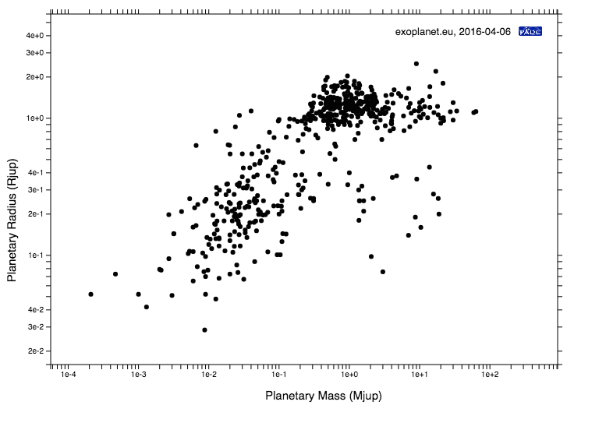
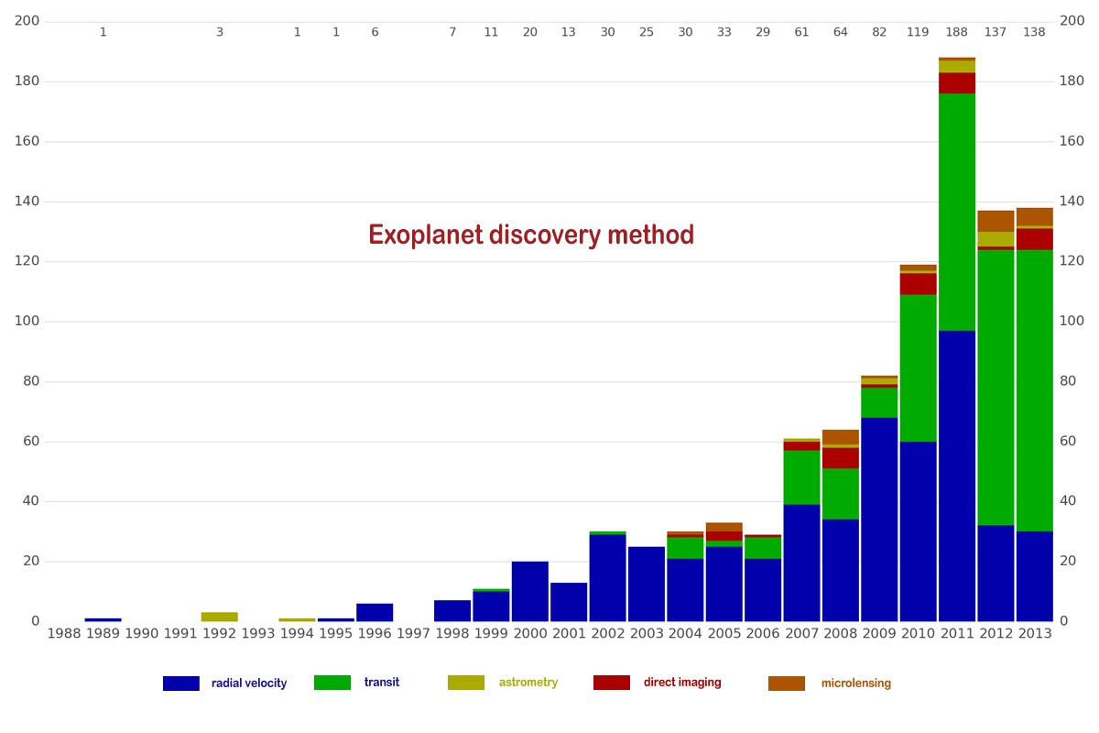
Background: Exoplanets
Charts generated by Exoplanets.org

Slide 3
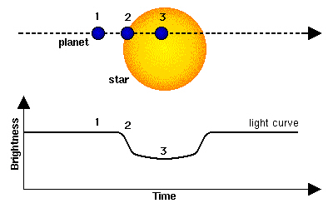
Transit Technique
Measures dimming of star light as planet passes in front of the star
Provides relative radius of the planet to the star
Image credit: ESA

Slide 4
Transit Technique
Transit data can be used to study exoplanet atmospheres
  Atmospheric structure and composition can be explored through observations at various wavelengths

Slide 5
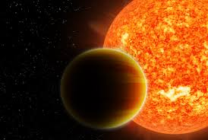
Hot Jupiter Exoplanets
Jupiter like in mass
High surface temperatures
  close orbit
  0.015 to 0.5 AU
Similar in atmospheric composition to Jupiter
  Hydrogen and Helium
Image: Haven Giguere, Nikku Madhusudhan

Slide 6
Rayleigh Scattering
U and B band observations can reveal the Rayleigh scattering slope
Rayleigh scattering in the atmosphere of hot Jupiter exoplanets can help break degeneracies in
  Radius
  Clouds
  Composition

Slide 7
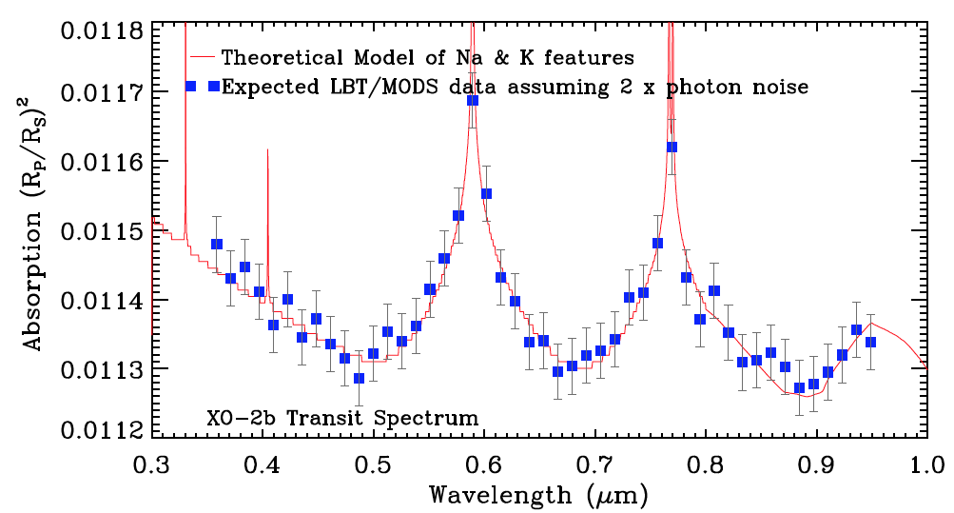
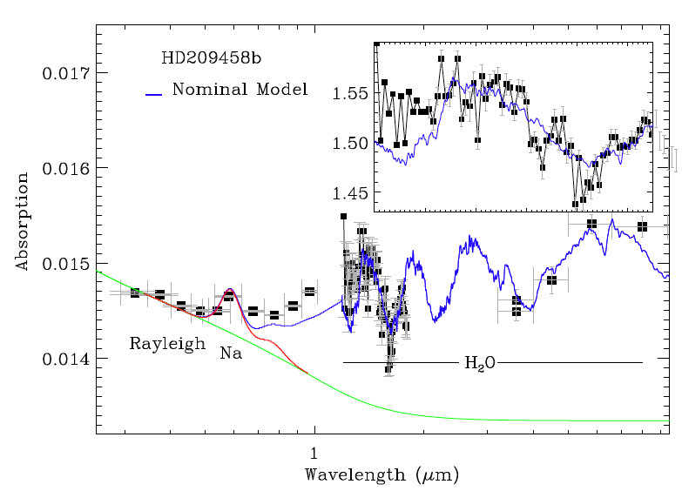
A typical model of a hot Jupiter optical and near-IR Spectrum
Knutson et al.
Griffith et al.

Slide 8
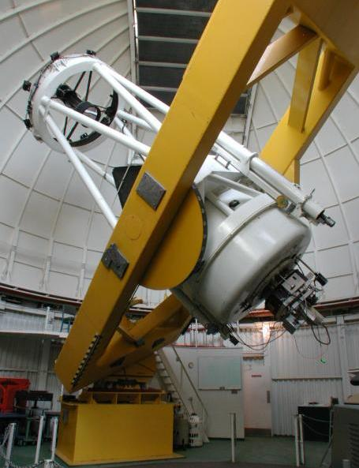
Observations
U of A’s Kuiper 1.55m Telescope/Mont4k
Simultaneous U and B band observations of a full transit including several hours of out-of-transit baseline
Multiple nights of observations for each target

Slide 9
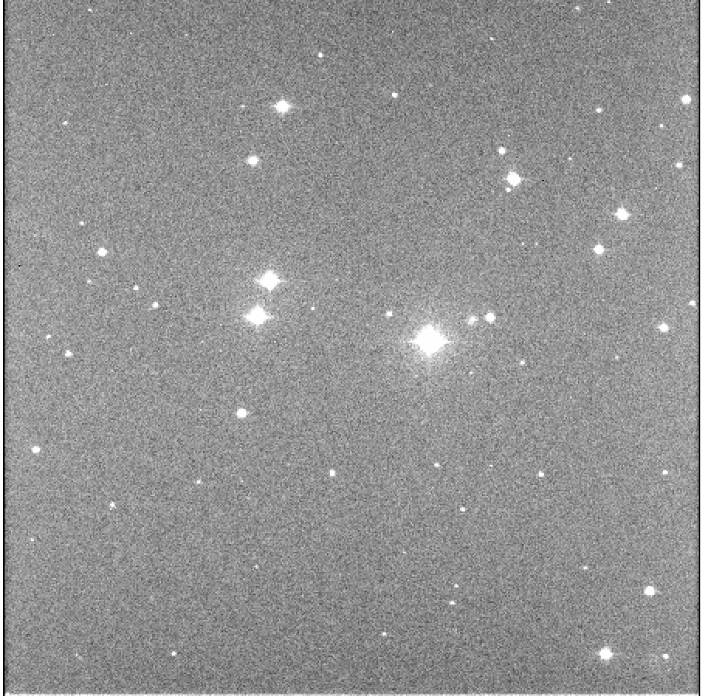
Multi Object Photometry
Remove effects of the Earth’s atmosphere
  Fluctuations in Earth’s atmosphere are much larger than the planetary signal
Divide host star signal by signal from reference stars
Kuiper 1.55m/ Mont4k image of exoplanet XO-2N b star field

Slide 10
Multi Object Photometry
Shared atmospheric systematics
Reference star choice
  Brightness
  Angular distance
  Stellar type
  Stellar variability
Kuiper 1.55m/ Mont4k image of exoplanet XO-2N b star field

Slide 11
Main Question: What is the best way to select and treat the reference stars?

Slide 12
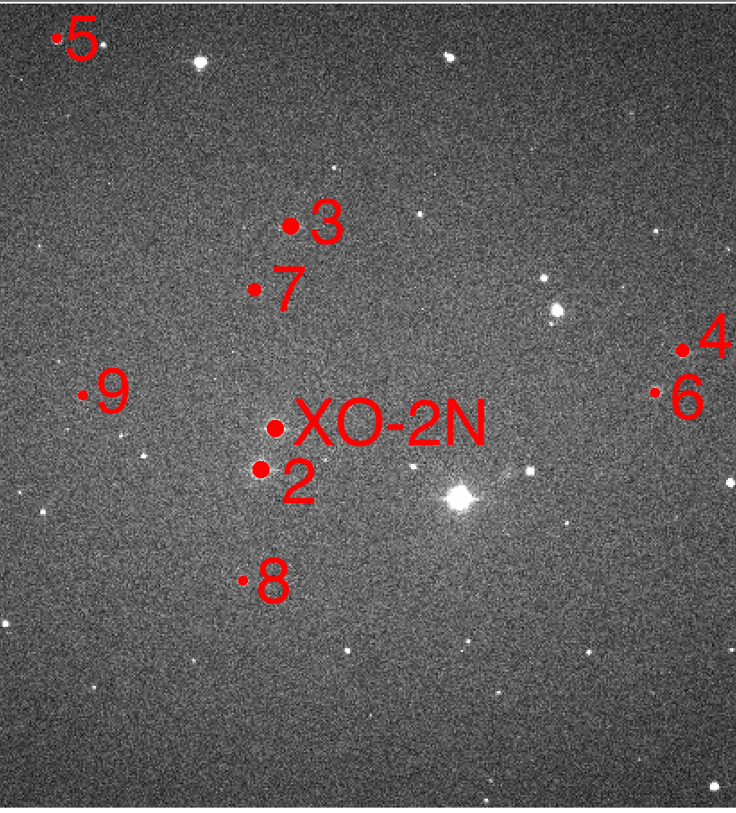
Multi Object Photometry
Complete a full reduction with every possible combination of 1,2,or 3 of the possible reference stars
  Reduction results in light curve of transit for which a model is fit
Kuiper 1.55m/ Mont4k image of exoplanet XO-2N b star field with possible reference stars shown.

Slide 13
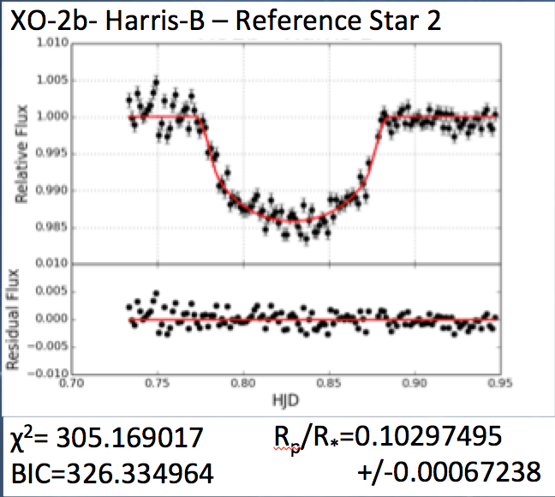
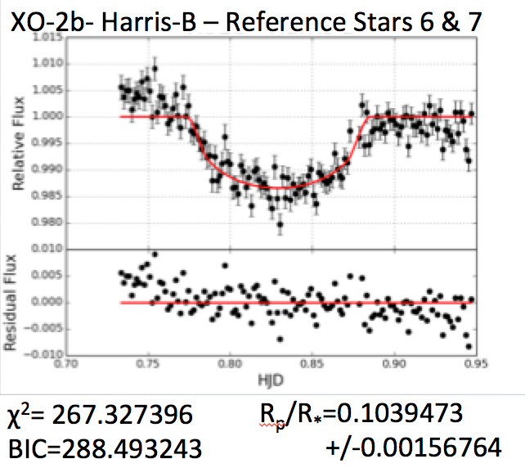
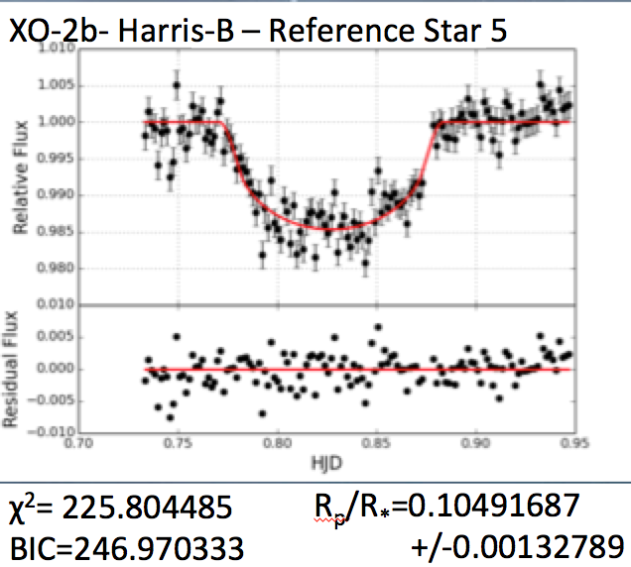
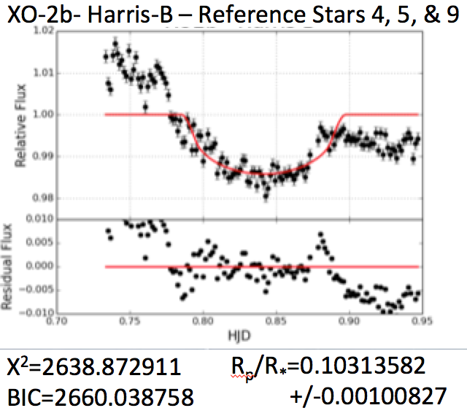
Data Reductions and Results
Reductions completed using ExoDRPL

Slide 14
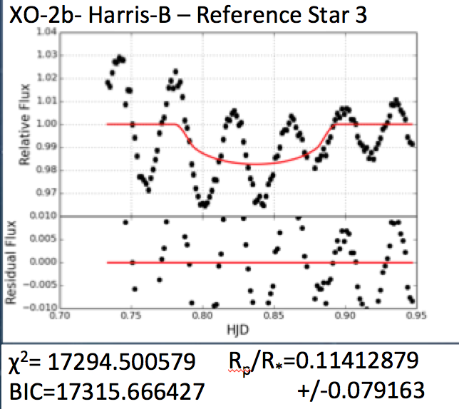
A New Variable Star?
It is interesting to note that in all cases where reference star 3 has been used in the reduction, a sinusoidal effect in the light curve is produced that drowns out the signal of the transit entirely, possibly indicating a short timescale variation for reference star 3.

Slide 15
Conclusion
For XO-2b, the companion XO-2S appears to be the best choice
  No significant improvement to the scatter or fit of the lightcurve when including other reference stars as well
  Not unexpected
Variability of XO-2N and XO-2S complicate the situation
  May eliminate XO-2S as a possible reference star choice
  Cause discrepancies in calculated parameters
  Interfere with ability to combine multiple nights of data
Preliminarily, trends seem to indicate that brighter reference star choices, with magnitudes similar to that of XO-2N produce the least scatter and best fit model
Can not yet comment on the effect of spectral type of the reference star or the out-of-transit assumptions
  We hope to do so in the future

Slide 16
Looking Forward
We aim to calculate and analyze light curves for all permutations of reference stars and various choices during reduction for multiple exoplanets and many nights of data
We will attempt to quantify the effect of various choices during the reduction
  treatment of atmospheric effects
  Reference star choice
  out-of-transit assumptions (e.g. linear, quadratic or exponential)
We aim to identify the best combination of reference stars in various fields
  Create consistent reductions over many nights of data

Slide 17
References
Claret, A., & Bloemen, S., 2011, AAP, 529, A75
Crouzet, N. Et al. 2012, ApJ, 761, 7
Damasso et al. 2015, A&A, 575, A111
Ford, E.B., 2005. ApJ, 129, 1706
Ford, E.B., 2006. ApJ 642,505
Gelman, A., & Rubin, D. B. 1992, StaSc, 7, 457
Mandel, K., & Agol, E. 2002, ApJ 642,505
Pearson, K. et al. 2014, NewAstronomy, 27, 102.
Press, W. H. et al., 1992 Numerical Recipes in C. The Art of Scientific Computing, 2nd edn. Cambridge Univ. Press,
Cambridge
Turner et al. 2014, in preparation
Zellem, R., et all. 2015, ApJ, 11, 11

Slide 18
Specific Data Reduction Techniques
In house automated reduction pipeline ExoDRPL created by Kyle Pearson (Pearson et al. 2013)
  Used to complete the reduction for each set of reference stars
  Generates series of IRAF scripts to calibrate using standard bias and flatfield reduction and perform aperture photometry using PHOT in IRAF DAOPHOT package
  Measures the flux from the target and reference stars at 100 different aperature radii (from 6 to 16 pixels with steps of 0.1) and choses the ideal aperature by minimizing the out-of-transit scatter
  The time varying flux of the reference stars is divided from that of the host star to eliminate major systematics
A model is fit to the lightcurve using a Mandel & Agol (2002) style fitting routine
  The planetary radius and mid-transit time are left as free paramaters
  A Levenberg-Mardquart non-linear least squares algorithm algorithm (Press et al. 1992; Mardquardt 2009) and a Markov Chain Monte Carlo (MCMC) algorithm (Ford 2005) are utilized to create a final fit and paramaters
  To de-trend the atmospheric extinction, we use a joint-simultaneous fit of the model lightcurve and a polynomial for which the order is determined by minimizing the Bayesian Information Criterion for each model fit
  The transit is modeled using an MCMC with 10 chains and 200,000 links
  The Gelmin Rubin statistic (Gelmin and Rubin 1992) is used to ensure chain convergence, as outlined in Ford 2006.
  The LM and MCMC solutions are checked for consistency for each model, but the MCMC uncertainties are quoted as they are more conservative.

Slide 19
Data Reductions and Results
Reductions completed using ExoDRPL

Slide 20
Data Reductions and Results
Reductions completed using ExoDRPL

